Slide 1
IMplementation and Comparision of KNN and its Improved Algorithm
Group Member: Xiaonan Hu, Liqi Zhu

Slide 2
Background
KNN（K-Nearest Neighbors）is widely applied in various fields, like text classification, picture processing, etc., as one of the most important classification algorithm in data mining. It’s a kind of inert supervised learning based on mature and understandable theory.
Notes:
As one of the Top 10 Algorithms in Data Mining , k-nearest neighbor (kNN) classification Algorithm has its almost simplest and complrelatively sophisticated theory, so that it is a supervised learning classification algorithm can always be easily realized.
The basic theory of kNN classification algorithm is to find a group of k objects in the training data set that are closet to the test object, and base the assignment of a label on the predominance of a particular class in this neighborhood . So there are three elements need to be fulfilled in order to implement the algorithm, including a set of labeled data, a measurement of distance (similarity), the parameter k indicates the number of nearest neighbors.
When given an unlabeled object, using kNN to classify, we should firstly calculate the distance of the certain point to each labeled data, then sort the distances and identify the k-nearest neighbors, finally votes of the class lables determines the class of the required object.

Slide 3
Problem Statement
KNN has its obvious drawbacks, as it's less inefficient and accurate.
Insufficient part of the imformation in training data causes data unclassified.
Lazy leaner algorithm leads to larger cost of computing and storage.
For this project, we will implement one improved algorithm of kNN classification based on information entropy of attributes values.
Notes:
However, this approach has its obvious drawbacks, because it is a lazy leaner algorithm, which means it will not generate a fixed model to classify the data, resulting in a larger cost for computing and storage.
And also, the traditional kNN algorithm use insufficient part of the imformation in training data leading to situations that data cannot be classified. Therefore, both in the aspect of efficiency and accuracy, kNN algorithm need to be improved.
For this project, we will implement one improved algorithm of kNN classification based on information entropy of attributes values, which integrates developments target at two of the potential aspects mentioned before: similarity measurement and neighbor discrimination, and try to provide a feasible idea for the further improvements of kNN.

Slide 4
Related Work
Simplify calculating methods or reduce computation load
Define new measurement standard for distance or similarity
Modify the threshold definition of k-nearest neighbors
Using advanced algorithm to select better value of parameter k
Ccombine with other algorithm
Notes:
aspectCurrent existing research relating to the improvement of kNN classification algorithm can be concluded into five basic s as follow: First, simplify calculating methods or reduce computation load to improve efficiency of the algorithm; Second, define new measurement standard for distance or similarity; Third, modify the threshold definition of k-nearest neighbors; Forth, using advanced algorithm to select better value of parameter k; Fifth, combine with other algorithm.

Slide 5
Methodology
K-nearest Neighbors Algorithm
Distance-weighted kNN Algorithm
Entropy-kNN
k-fold cross validation
Notes:
k-nearest Neighbors Algorithm: easy to interpret, accurate; but inefficient and sensitive to data structure.
Distance-weighted kNN Algorithm: better than kNN by improving decision rule.
Entropy-kNN: using information entropy as distance entropy, expected to improve both the accuracy and efficiency of kNN.
k-fold cross validation: acquire more objective results, redusing sensitivity of data noise or bias generated by sampling

Slide 6
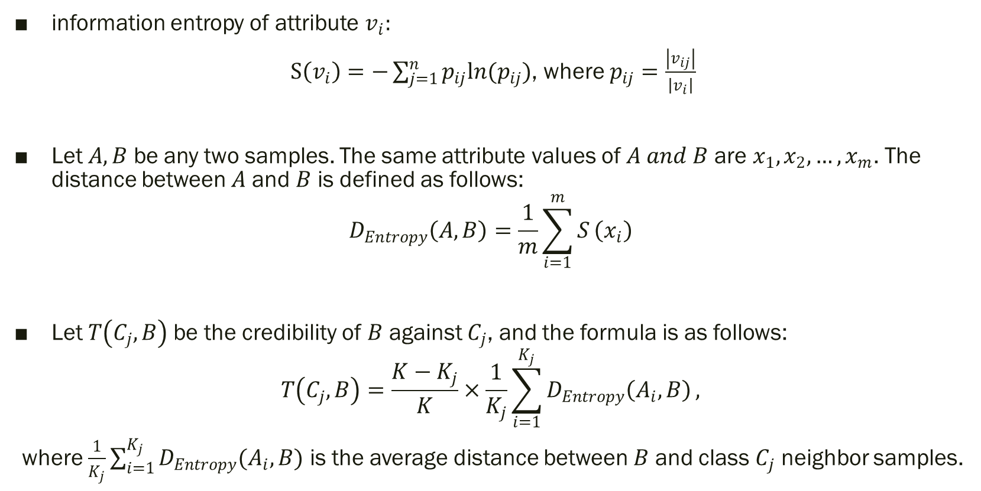
Concept of Entropy-KNN algorithm
information entropy of attribute $v_{i}:$
$S\left(v_{i}\right)=−\sum_{j=1}^{n}{p_{ij}ln(p_{ij})}$, where $p_{ij}=\frac{\left|v_{ij}\right|}{\left|v_{i}\right|}$
Let $A,B$ be any two samples. The same attribute values ​​of $A and B$ are $x_{1},x_{2},…,x_{m}$. The distance between $A$ and $B$ is defined as follows:
$$D_{Entropy}\left(A,B\right)=\frac{1}{m}\sum_{i=1}^{m}{S}\left(x_{i}\right)$$
Let $T\left(C_{j},B\right)$be the credibility of $B$ against $C_{j}$, and the formula is as follows:
$$T\left(C_{j},B\right)=\frac{K−K_{j}}{K}×\frac{1}{K_{j}}\sum_{i=1}^{K_{j}}{D_{Entropy}\left(A_{i},B\right)},$$
where $\frac{1}{K_{j}}\sum_{i=1}^{K_{j}}{D_{Entropy}(A_{i},B)}$ is the average distance between $B$ and class $C_{j}$ neighbor samples.
Notes:
According to the definition of information entropy, it can be used to measure the importance of attribute value to class decision. The smaller the entropy is, the stronger the decision-making ability of corresponding attribute value is. The Entropy-KNN algorithm based on information entropy is used to redefine the measure of similarity, replacing the traditional KNN algorithm with the average information entropy of the same attribute value shared by any two samples. Entropy-KNN algorithm selects the K training samples nearest to the sample to be tested according to the distance defined based on the entropy of the eigenvalue. The average distance between neighbor sample and sample to be classified and the portion of frequency are considered complementarily to determine the class of sample to be tested.

Slide 7
Entropy-KNN Algorithm Analysis
The Entropy-KNN algorithm based on attribute value information entropy improves the distance calculation method based on information entropy, and defines the concept of class credibility as classification criteria, theoretically improves the accuracy and discriminant efficiency of KNN algorithm.
Notes:
Distance measure defined by Entropy-KNN algorithm based on the attribute value of information entropy is equivalent to indirect extraction of all the information with specific attribute values ​​of training samples to provide a reference for classification for the sample point. Compared with the traditional KNN algorithm, the Entropy-KNN algorithm makes full use of the feature information of the training sample set and quantifies the corresponding weights of the eigenvalues ​​for the classification decision.
In addition, the Entropy-KNN algorithm is also optimized in the classification decision strategy. Traditional KNN algorithm uses simple voting counting method and distance-weighted KNN algorithm simply considering the distance voting method, Entropy-KNN combines the decision-making criteria of the first two algorithms simultaneously, considering number of trainging samples of each class in K Neighbors and the average distance between the class to be classified and each class of K nearest neighbor. This definition of decision index can effectively avoid the influence of noise point in K neighbors on decision.

Slide 8
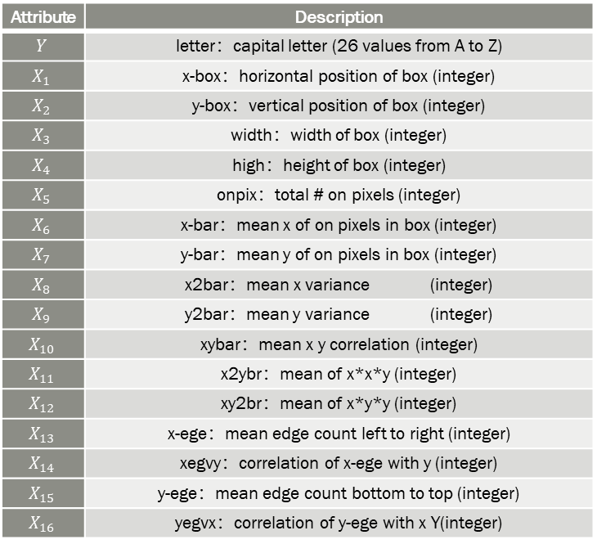
Experiment
Datasets:
Letter Recognition Data Set
NBA Player Data Set
Attribute | Description
$$Y$$ | letter：capital letter (26 values from A to Z)
$$X_{1}$$ | x-box：horizontal position of box (integer)
$$X_{2}$$ | y-box：vertical position of box (integer)
$$X_{3}$$ | width：width of box (integer)
$$X_{4}$$ | high：height of box (integer)
$$X_{5}$$ | onpix：total # on pixels (integer)
$$X_{6}$$ | x-bar：mean x of on pixels in box (integer)
$$X_{7}$$ | y-bar：mean y of on pixels in box (integer)
$$X_{8}$$ | x2bar：mean x variance (integer)
$$X_{9}$$ | y2bar：mean y variance (integer)
$$X_{10}$$ | xybar：mean x y correlation (integer)
$$X_{11}$$ | x2ybr：mean of x*x*y (integer)
$$X_{12}$$ | xy2br：mean of x*y*y (integer)
$$X_{13}$$ | x-ege：mean edge count left to right (integer)
$$X_{14}$$ | xegvy：correlation of x-ege with y (integer)
$$X_{15}$$ | y-ege：mean edge count bottom to top (integer)
$$X_{16}$$ | yegvx：correlation of y-ege with x Y(integer)
Attribute | Description
TARGET_5Yrs | 1 if career length >=5, 0 if career length <5
GP | Games played
MIN | Average minutes played
PTS | Average points per game
FG% | Field goal percentage
3P% | 3-point goal percentage
FT% | Free throw goal percentage
REB | Average rebounds per game
AST | Average assists per game
STL | Average steals per game
BLK | Average blocks per game
TOV | Average turnovers per game
URL:
Notes:
The first data set is the Letter Recognition Data Set from UCI, which contains 20000 samples, each of which characters image features classified by 26 letters, 16 attributes in total. And all the value of attributes take the integers range in 0-15. Each attribute’s name and meaning shows in table
The second data set is for Predicting 5-Year Career Longevity for NBA Rookies, which contains 1340 samples, to facilitate the following experiments, we only take 11 attributes and level them into 10 level as integers range in 0-9. And the data will fall in two classes as whether a NBA player will last 5 years in league. All the attributes take and their meanings shown in following table

Slide 9
Experiment
Experiment Design:
Four-phase Comparasion
Set relatively large size of training data, compare the accuracies of classifiers.
Implement the three algorithms on different size of training data, based on the accuracies acquired
Targets on the influence of value k
How dataset’s characrastic affects the classification algorithm’s accuracy
Notes:
Generally, the experiments for this project will be divided into three major portions. The first part of the experiment, we will set a relatively large size of training data, and then compare the accuracies of classifiers: kNN, distance-weighted kNN and Entropy kNN, based on the same test data set. The second part of experiments will be respectively implement the three algorithms on different size of training data, based on the accuracies acquired, the influence of training data sets' size for each algorithm can be observed. The last part of experiments, targets on the influence of value k, will reveal the effect of k value for each algorithm, based on relatively smaller training data sets. The former three portions of experiments are all implement on the letter recognition data set, and the fourth part experiment will be applied in the other NBA data set, so that we can acquire a view of how data sets’ characteristics will affect the classification algorithm’s accuracy.
To acquire relatively objective results for the experiments, 10-folds cross validation will be implemented. The whole data set will be petitioned into ten folds, every experiment will take one of the folds as training data set, and the others as test data set. The average accuracy for ten times experiments will be recorded and compared.

Slide 10
Experiment
Results:
k=10, Classification accuracies
on different sizes of training data
Accuracies for k=10, training data size=2000
No./Acuracy | kNN | Distance-weighted | Entropy-kNN
1 | 0.737 | 0.778 | 0.842
2 | 0.743 | 0.784 | 0.817
3 | 0.754 | 0.796 | 0.817
4 | 0.760 | 0.799 | 0.805
5 | 0.767 | 0.812 | 0.828
6 | 0.752 | 0.790 | 0.783
7 | 0.755 | 0.797 | 0.801
8 | 0.761 | 0.795 | 0.826
9 | 0.774 | 0.812 | 0.782
10 | 0.761 | 0.804 | 0.792
Average accuracy | 0.756 | 0.797 | 0.809
Notes:
The first part experiment take 10 sets of data, each contains a training data set of 2000 and a testing data set of 18000. Implement all three algorithms with k=10, and record the 10 accuracies for each algorithm, calculate the average and compare.
As the results shown in Table, when k=10 and training data size=200, compared to classic kNN algorithm, distance-weighted kNN improves the performance in accuracy, 4.1 percent in average; however, Entropy-kNN elevated less compared to distance-weighted kNN algorithm.
while the information already known is sufficient, which as training data set is relatively large, Entropy-kNN algorithm lightly better off compared to kNN and distance-weighted kNN especially. And because, Entropy-kNN has a far more complex computing process, and takes longer time, for situation like this with sufficient data known, distance-weighted kNN is a reasonable and efficient choice within the allowable error range.
The second part of the experimental comparison of the accuracy of the three algorithms shown in Figure. Comparing the three average accuracy curves of KNN, distance-weighted KNN and Entropy-KNN, it is easy to see that the Entropy-KNN algorithm has more accuracy advantages when the training set is smaller.compared with the traditional KNN algorithm, the Entropy-KNN algorithm can dig and use more information mining from the training set information, and still can extract sufficient available information in a small training data set, to effectively improve the accuracy of the classification algorithm. Therefore, the Entropy-KNN algorithm is a more suitable classification algorithm when training data samples are relatively scarce.

Slide 11
Experiment
Results:
Accuracies for k=10, training data size=134
Training data size=200,
Classification accuracies with different k
No./Acuracy | kNN | Distance-weighted | Entropy-kNN
1 | 0.645 | 0.710 | 0.958
2 | 0.651 | 0.716 | 0.933
3 | 0.662 | 0.728 | 0.933
4 | 0.668 | 0.732 | 0.921
5 | 0.675 | 0.743 | 0.944
6 | 0.660 | 0.722 | 0.899
7 | 0.663 | 0.729 | 0.917
8 | 0.669 | 0.727 | 0.942
9 | 0.682 | 0.744 | 0.898
10 | 0.669 | 0.737 | 0.908
Average accuracy | 0.664 | 0.729 | 0.925
Notes:
In the third part of experiment, the method is as follows: Firstly, randomly select 2000 samples from the dataset as the new dataset, and then perform 10-fold cross validation on the new dataset. Run kNN algorithm, distance-weighted kNN algorithm and Entropy-kNN algorithm, and take k value respectively as 5,10, ..., 50. Finally, we can get the experiment results within a training set size of 200, using different values for parameter k. Then we do the comparative analysis of accuracy for kNN, distance-weighted kNN and Entropy-kNN respectively.
As experiment results shown in Figure 2, it can be easily seen that when the training data sets are small, both the traditional KNN algorithm and the distance-weighted KNN algorithm are more likely to be affected by the K value; that is, when the K value increases and there are too many points belonging to other classes are included in the neighborhood.
The last part of experiment implemented on the NBA data set, with training data size of 134 and k=10, still using kNN, distance-weighted kNN and Entropy-kNN respectively, and evaluate with 10-fold cross validation. The experiment results shown as above.
From this part of experiment, we achieved better result and relatively large improvement with Entropy-kNN compared to kNN and distance-weighted kNN. After analysis, we conclude the main reason is that the dataset used in this experiment has less data classes with sufficient attributes, however, the letter recognition data set has relatively more classes, which leads to a generally increase on attributes information entropy and so to the relative dispersed decision power.

Slide 12
Conclusion
Entropy-KNN has obvious improvement in classification accuracy compared with traditional KNN algorithm, especially when the existing training sample information is limited.
Entropy-KNN algorithm performs more cyclic during calculation
Entropy-KNN algorithm has a relatively small sensitivity to the selection of K value
Still needs to be further improved in terms of computational efficiency
Notes:
The Entropy-KNN algorithm is optimized for both the distance measurement method and decision-making method in the traditional KNN algorithm. Firstly, Entropy-KNN algorithm extracts the information of the importance of each attribute value to the class decision based on the training sample set, so as to define the similarity between the sample under test and the training sample to be measured by the average information entropy of the same attribute value therebetween. We use the training sample set information more efficiently to extract the nearest neighbor sample which is similar to the sample to be tested. Secondly, we define a new class decision criterion - class credibility considering the number and average distance of neighbor samples of each class. Therefore, it is more effective and accurate to distinguish the credibility of the samples to be tested and to further improve the accuracy of the classification.
Comparing the above three experiments on UCI's letter recognition dataset, it can be known that Entropy-KNN has obvious improvement in classification accuracy compared with traditional KNN algorithm, especially when the existing training sample information is limited (ie. when the training sample set is small), Entropy-KNN algorithm outperforms the traditional KNN algorithm and distance-weighted KNN algorithm obviously. When the size of training sample set increases gradually, The relative advantage of Entropy- KNN algorithm is gradually reduced. Therefore, with a large training sample set, the KNN algorithm or the distance-weighted KNN algorithm can be selected within the allowable error range. In addition, the Entropy-KNN algorithm has a relatively small sensitivity to the selection of the K value, and the Entropy-KNN algorithm can still obtain a higher classification accuracy when the K value increases, while the KNN algorithm and the distance-weighted KNN algorithm are more likely to be interfered by increased noise sample point.
However, the Entropy-KNN algorithm performs more cyclic during calculation, resulting in less efficiency. The comparison between the experimental data, by comparing the results of letter recognition data set and NBA data set, we found that the improvement effect of Entropy-KNN in the experiments on the former one data set is relatively insignificant. After analysis, the main reason is that Data sets have more data types and eigenvalues, which leads to the relative dispersion of attribute values ​​for each class and information entropy of attribute values is generally increased. Based on the above two issues, I think one of the most feasible ways is to pre-process the training sample set accordingly, such as clustering training sample sets. Such processing can not only reduce the computational complexity to effectively improve the efficiency of the algorithm, but also effectively solve the problem that the Entropy-KNN algorithm has a poor performance in the case of a large number of eigenvalues.
Although the traditional KNN algorithm has a simple and easy-to-understand theoretical basis, it has the disadvantages of complex computation, low efficiency and low accuracy. In this paper, Entropy-KNN, an improved KNN algorithm based on the concept of information entropy, is selected for our experimental analysis. Then a total of four experiments were carried out on UCI's letter recognition dataset. The results show that the Entropy-KNN algorithm can effectively improve the classification accuracy of KNN algorithm. Especially when the training sample set is small, its performance is obviously better than the traditional KNN algorithm and distance-weighted KNN algorithm; Entropy-KNN algorithm has a relatively small sensitivity to the selection of K value, Entropy-KNN algorithm can still obtain higher classification accuracy when K value increases. However, the Entropy-KNN algorithm still needs to be further improved in terms of computational efficiency, and the analysis suggests that the clustering of training sample sets is a possible improvement of the algorithm.

Slide 13
Bibliography
[1] Wu X,Kumar V,Ross Quinlan J,et al.Top 10 algorithms in data mining[J]. Knowledge and Information Systems,2008,14(1).
[2] Wei L., Zhao X., Zhou X. (2015) An Enhanced Entropy-K-Nearest Neighbor Algorithm Based on Attribute Reduction. In: Wong W. (eds) Proceedings of the 4th International Conference on Computer Engineering and Networks. Lecture Notes in Electrical Engineering, vol 355. Springer, Cham
[3] k-Nearest Neighbour Classifiers –Pádraig Cunningham, Sarah Jane Delany — 2007
[4] Application of k-Nearest Neighbor on Feature –Projections Classifier To, Tuba Yavuz, H. Altay Guvenir — 1998 — Proceedings of ISCIS-98, 13th International Symposium on Computer and Information Sciences
[5] MKNN: Modified K-Nearest Neighbor –Hamid Parvin, Hosein Alizadeh, Behrouz Minaei-bidgoli
[6] k Nearest Neighbor Classification across –Multiple Private Databases, Li Xiong — 2006 — In Proceedings of ACM International Conference on Information and Knowledge Management
[7] Classification with Learning k-Nearest Neighbors –Jorma Laaksonen, Erkki Oja — 1996
[8] Extending the K-Nearest Neighbour Classification –Algorithm To Symbolic, Floriana Esposito, Donato Malerba, Marianna Monopoli.

